Slide 1
B.E ELECTRONICS AND COMMUNICATION ENGINEERING EC5512 – SUMMER INTERNSHIP / SUMMER PROJECT
OBSTACLE AVOIDING VOICE CONTROL ROBOT
MANOJH.U.S (2019105031)
GOWTHAM.T (2019105533)
JAGAN.S (2019105538)
PRADEEP.T (2019105555)

Slide 2
ABSTRACT
This robot or a smart car is built to sense any obstacle in its path, to avoid it and resume its running involving the pre-computation of an obstacle free path.
Obstacle detection and avoidance can be considered as the central issue in designing mobile robots.
This technology provides the robots with senses which it can use to traverse in unfamiliar environments without damaging itself.
It employs ultrasonic distance sensors to detect obstacles.
The Arduino UNO is selected as the microcontroller platform and its software counterpart. Arduino IDE, is used to carry out the programming.

Slide 3
HARDWARE AND SOFTWARE REQUIREMENTS
Hardware Requirements:
Arduino UNO
L293D Motor Driver Shield
4x DC gear motor
Ultrasonic Sensor
1x Micro Servo motor
HC 05 Bluetooth module
Battery
Switch
Male and Female Jumper Wires
Software Requirements:
Arduino IDE

Slide 4
BLOCK DIAGRAM
Battery
Left Side Wheels
ARDUINO
UNO
Ultrasonic Sensor
Motor Driver
Shield
Servo Motor
Right Side Wheels
HC-05

Slide 5
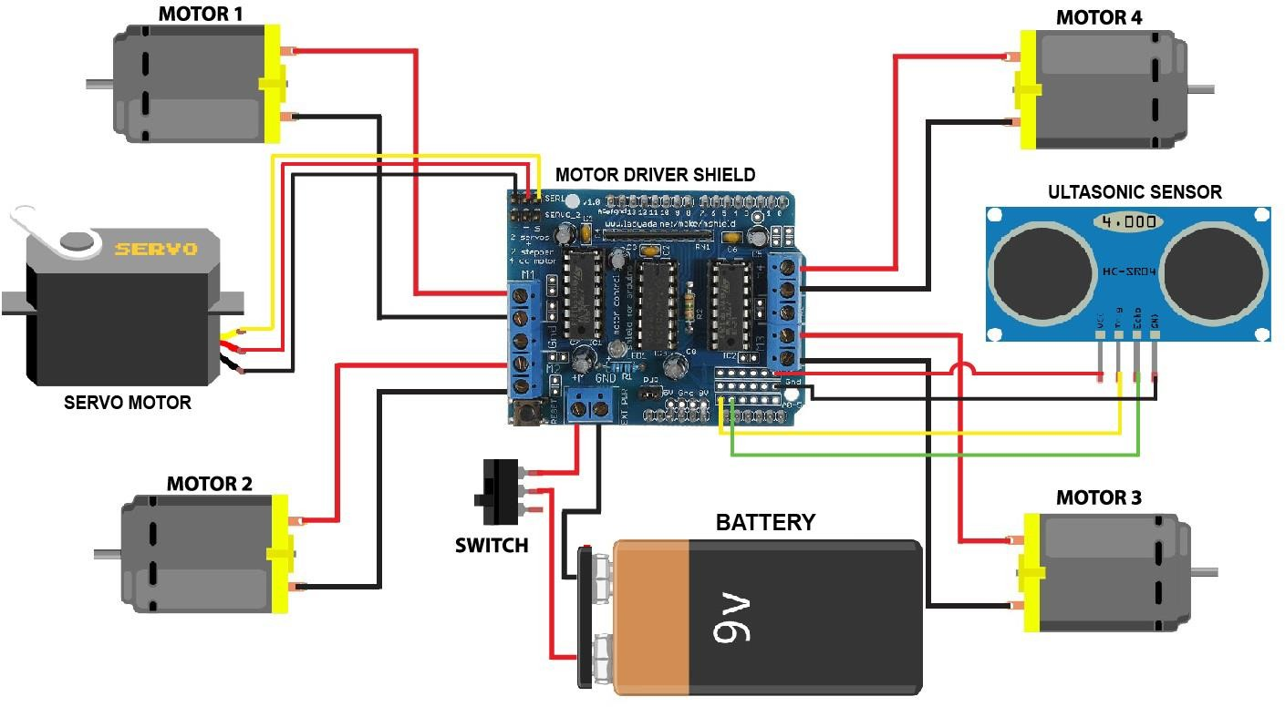
Circuit diagram

Slide 6
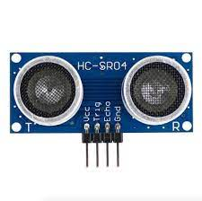
PROPOSED METHODOLOGY
The robot in this project detects obstacles with the help of ultrasonic sensor to measure distances to surrounding objects.
The ultrasonic sensor used here is HC-SR04.
It measures distances over a range of 2cm to 400cm which is more than enough for our robot to detect and avoid obstacles.

Slide 7
PROPOSED METHODOLOGY
The ultrasonic sensor is mounted on the servo motor. Using the servo motor the sensor is turned left and right.
The sensor measures the distance between the object and robot and makes the robot to go straight or left or right depending on the side where the distance to object is larger.
If the sensor detects obstacle on all three sides, it will move backward and again checks for the distance to objects.

Slide 8
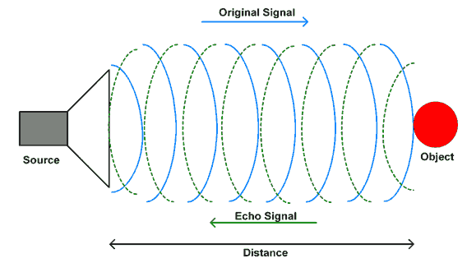
PROPOSED METHODOLOGY
The ultrasonic sensor emit an ultrasonic pulse every 300 ms which echoes from the neighboring objects.
Using time difference between the input and echo, the Arduino calculates the distance to the obstacle from which the echo is coming by using the constant speed of sound 340 m/s.
Distance = (Time * Speed Of Sound) / 2

Slide 9
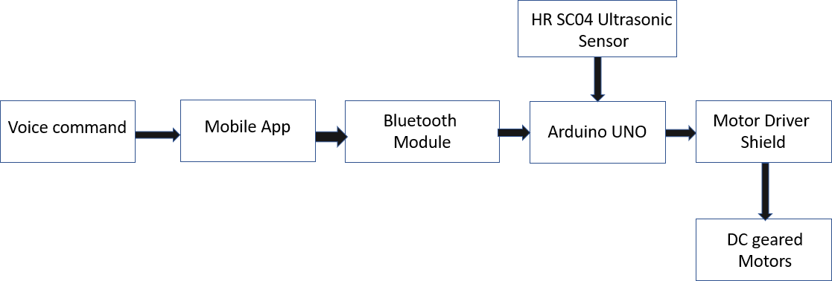
Architecture :
Input of the voice command through android app
Detection of hurdle by the robot
Speed control of the robot
Automatic braking system

Slide 10
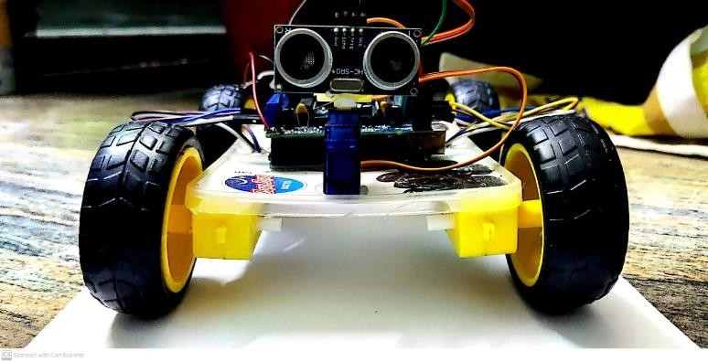
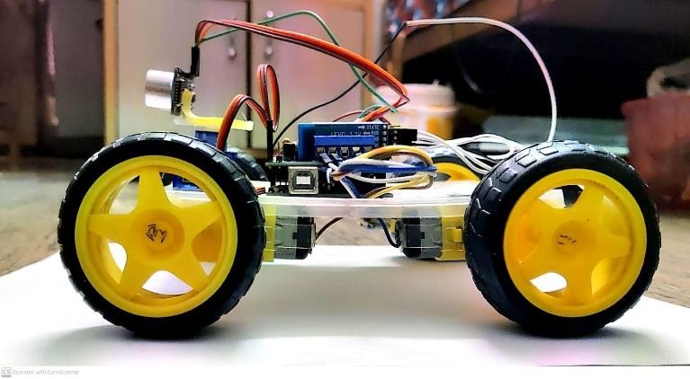
Commands and Tasks
S.No | Voice commands through app | Output (Movement)
1 | move forward | Robot goes forward
2 | move backward | Robot goes backward
3 | turn right | Robot turns right
4 | turn left | Robot turns left
5 | Stop | Robot stops

Slide 11
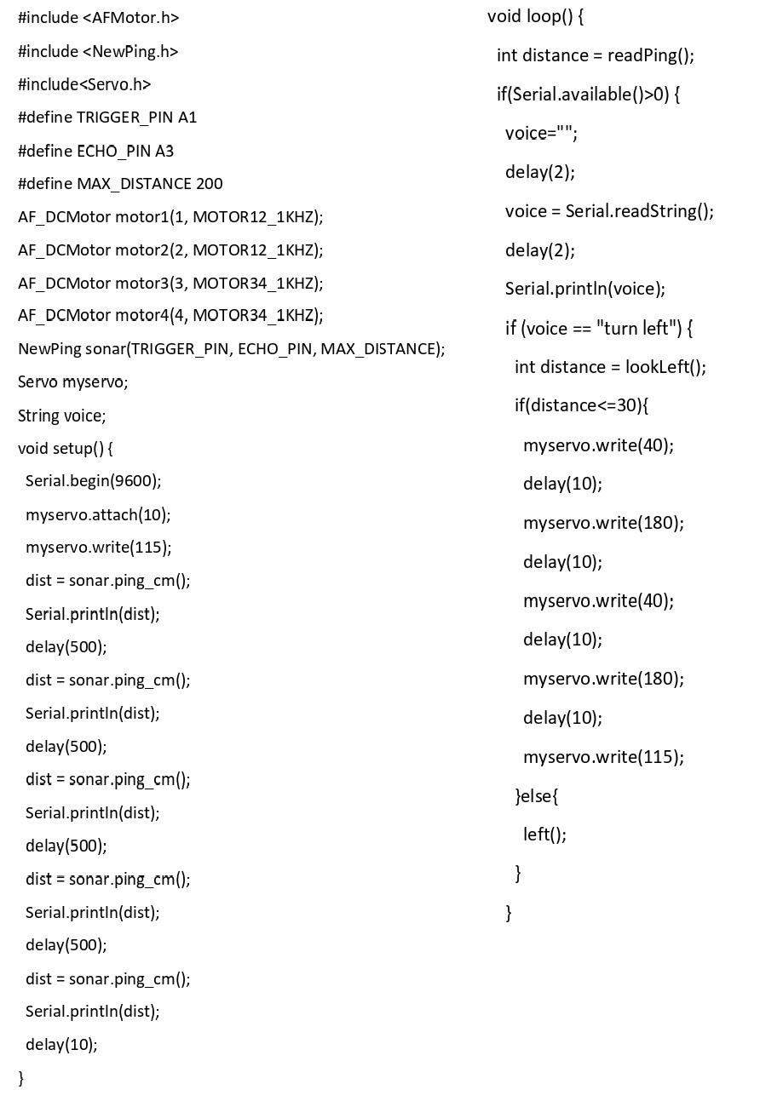

Slide 12
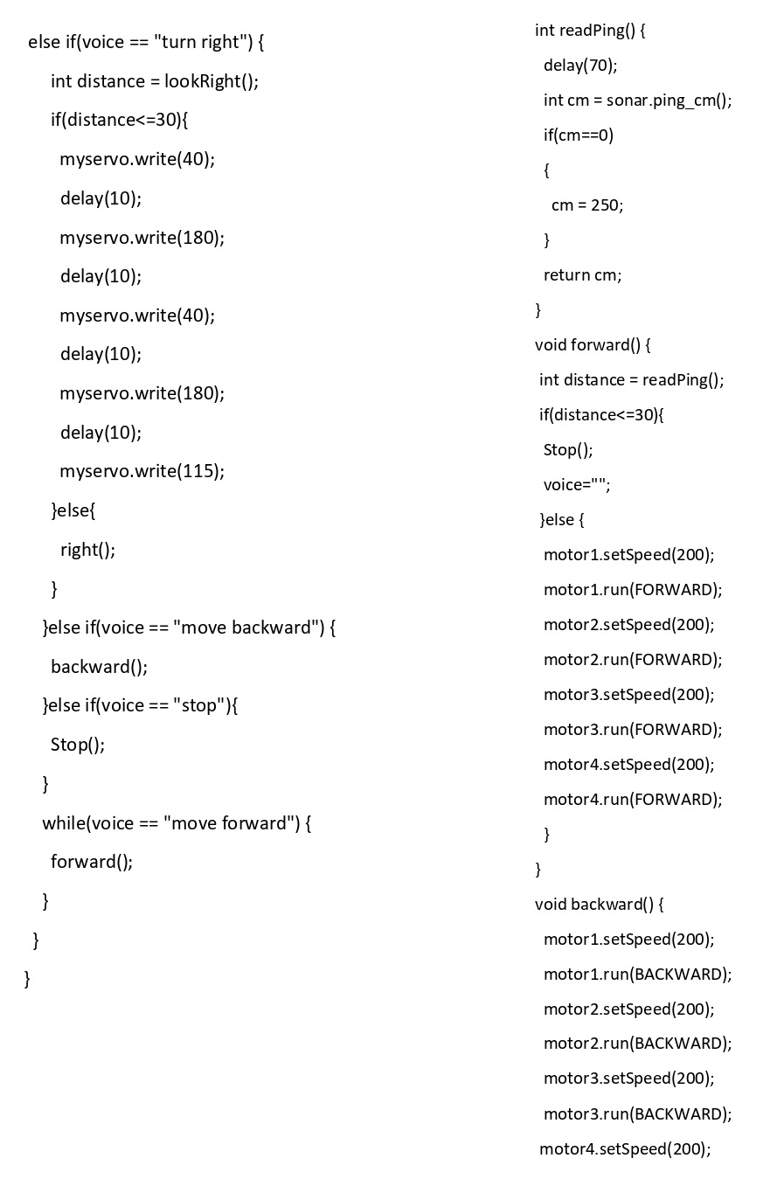

Slide 13
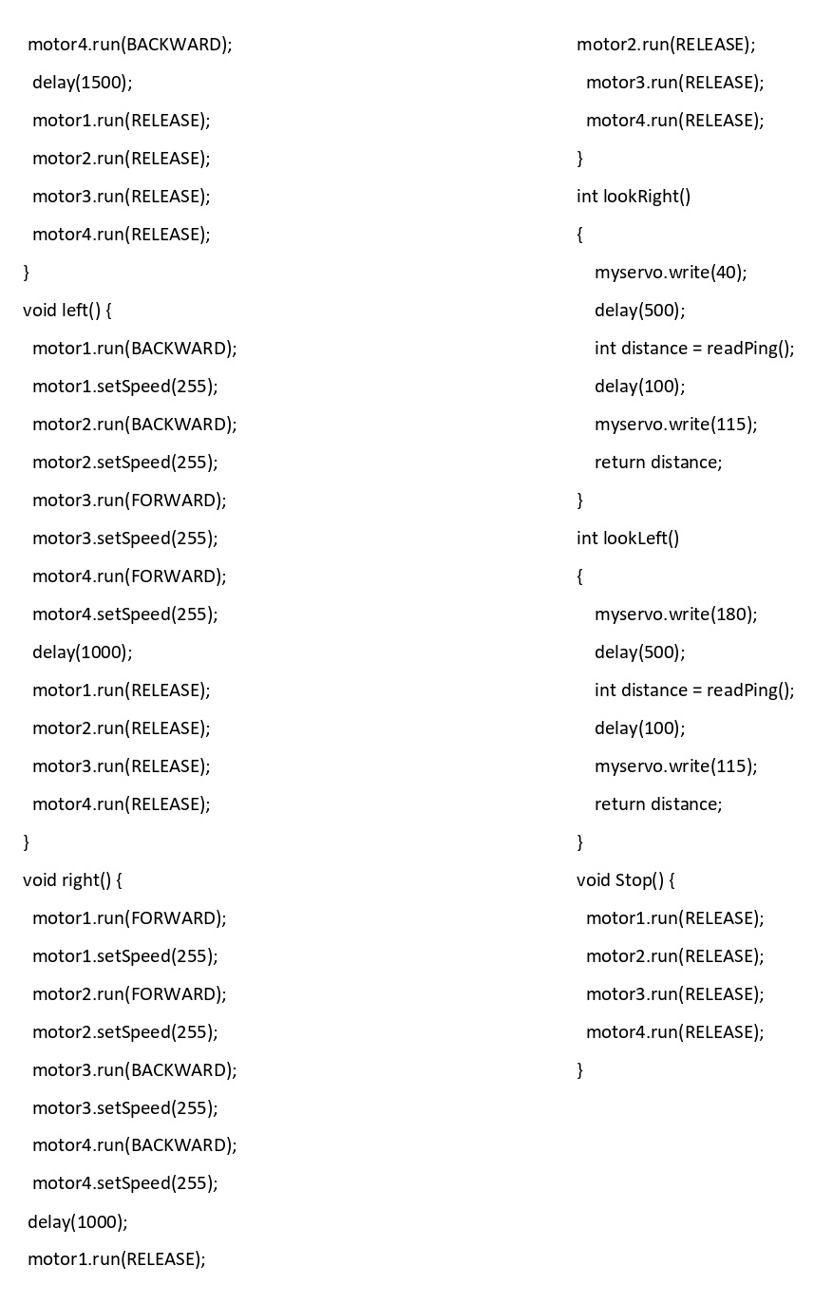

Slide 14
OBJECTIVE
The objective is to design a robot that avoids the obstacles that comes its way and sense a better path where the obstacles are at maximum distance.
The voice control feature which is integrated in the robot acts as a joystick to control the robot. But by the obstacle avoiding feature it does not blindly follow the stupid instructions given and gets crashed but it suggest the alternative path.
This robot is designed for industrial purpose. Many industries need an intelligent robot to transport heavy materials within its premises. This need can be fulfilled by this bot.

Slide 15
THANK YOU

